Slide 1
Factory Energy Optimization
Mrunal Shende
x24245909@student.ncirl.ie

Slide 2
agenda
To highlight the potential of modern technologies to improve system inability and operational efficiency in factories.

Slide 3

Introduction
Energy consumption is one of the most significant operational costs in modern factories.
This project aims to address these challenges by designing and implementing a complete energy monitoring system that uses IoT sensors, fog computing, cloud services, and real time dashboards.
This Photo by Unknown Author is licensed under CC BY-NC

Slide 4
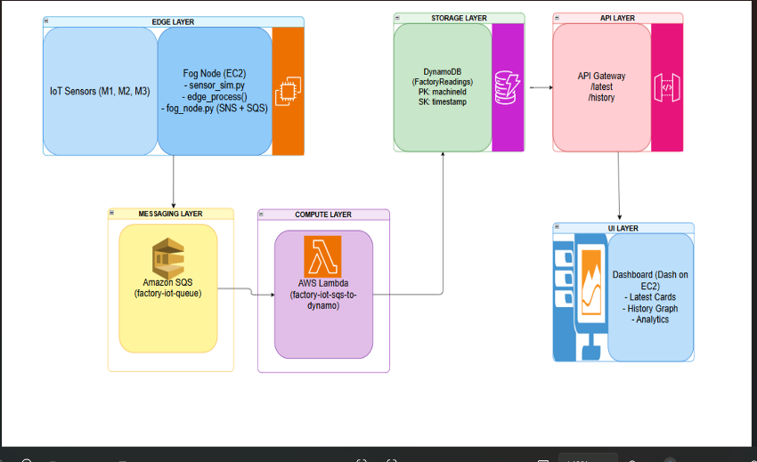
Architecture Diagram

Slide 5
Components
Sensors:
Energy Usage
Temperature
Humidity
Machine Load
Aws Services:
Lambda
Aws Gateway
DynamoDB
EC2
Cloud9
SNS
SQS
GitHub

Slide 6
Methodology
Sensor simulation and real data integration
Edge Processing and local Alerts
Messaging through Amazon SQS
Batch Upload to API Gateway
AWS Lambda for Cloud Processing
Dynamo DB for Storage
API Gateway for Data Access
Dashboard Implementation on EC2
CI/CD pipeline Using Github Actions

Slide 7
Problem I faced
I was sending data directly from sensor to DynamoDB, which was losing some data in between, which cause delay and not accurate decisions.
So, I used SQS , which act as buffer between Fog node and the cloud processing.
I was also facing Cloud9 preview problem, so I uploaded my dashboard to EC2 which serves more quickly.
While creating CI/CD pipeline I was facing SonarQube platform error, which I resolved by updating SonarQube and EC2 key.

Slide 8
Thank you
Mrunal Shende
x24245909@student.ncirl.ie

